Slide 1
Cardiac Action Potential Prediction Using Recurrent Neural Networks and Reservoir Computing Techniques: A Comparative Study
Shahrokh Shahi*, Flavio H. Fenton, Yohannes Shiferaw, and Elizabeth M. Cherry
School of Computational Science and Engineering
Georgia Institute of Technology
May 2021

Slide 2
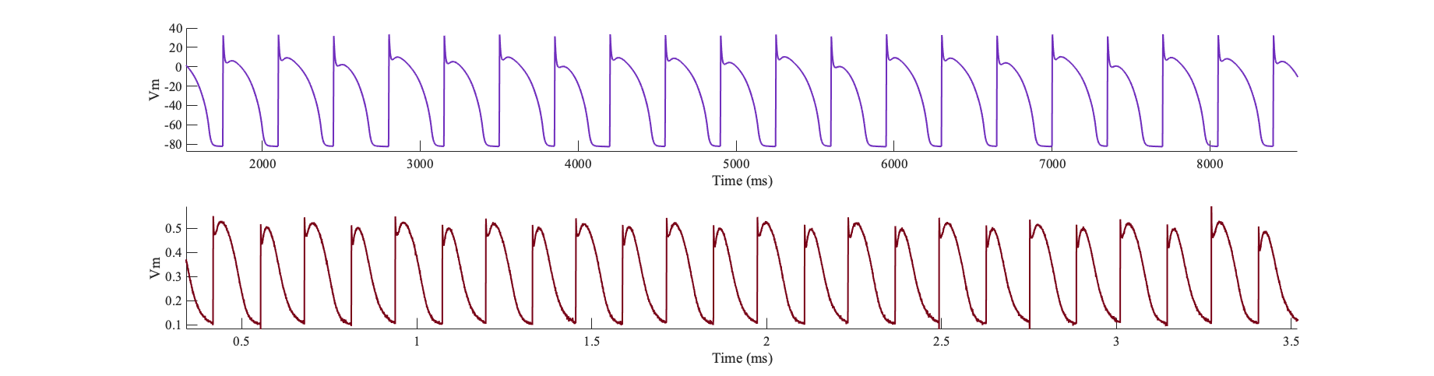
Introduction
Comparative study
Deep learning approaches for modeling cardiac action potential
  Gated recurrent neural networks
  Reservoir computing
Cardiac electrophysiological signaling as a complex nonlinear dynamical system
Time series forecasting
  Financial and market forecasting, weather forecasting, medical diagnosis, computer systems, brain-computer interface, social networks
  Cardiac action potential

Slide 3
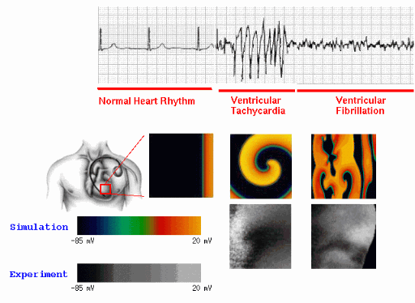

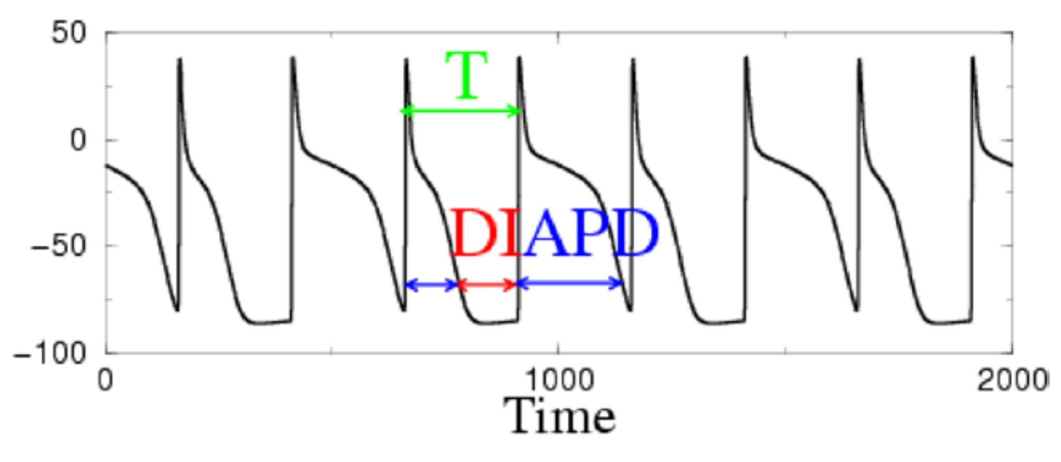
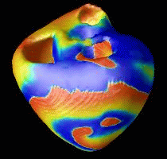
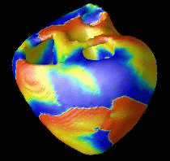
Introduction
Arrhythmia
  Disruption to the normal propagation of
  electrical waves (action potentials)
  Most serious (e.g., fibrillation): reentrant waves
Alternans
  Cardiac instabilities known to lead to the development of arrhythmias
  A beat-to-beat alternation in the duration of action potentials
  Nonlinear dynamics
[1] Fenton, F. H. et al. (2009). Termination of atrial fibrillation using pulsed low-energy far-field stimulation. Circulation, 120(6), 467.
[2] Alonso, S., Bär, M., & Echebarria, B. (2016). Nonlinear physics of electrical wave propagation in the heart: a review. Reports on Progress in Physics, 79(9), 096601.

Slide 4
Modeling Approaches
Modeling and studying cardiac electrophysiological signaling
Modeling approaches
  Mathematical models
    Explain how transmembrane currents and the underlying ionic processes generate action potential
    Insights into the fundamental mechanisms
  Data-driven models; Machine learning
    Recurrent neural networks (RNNs)
      Long short-term memory (LSTM) networks
      Gated recurrent units (GRUs)
    Reservoir computing
      Echo state networks (ESNs)
      Hybrid echo state networks (HESNs)
    Comparative study: performance, prediction accuracy, computational time, trade-offs

Slide 5
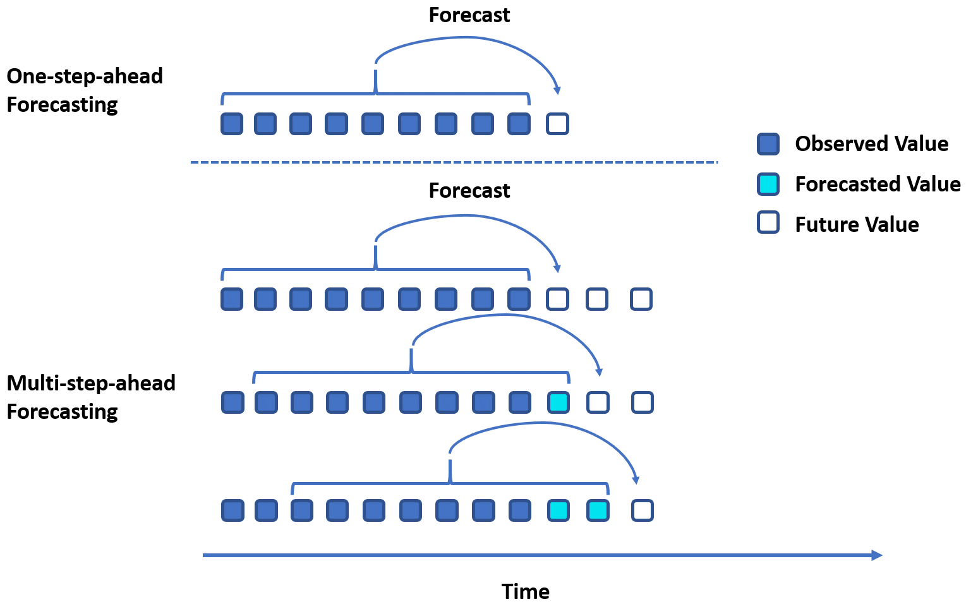
Time-series Modeling
Sequence modeling; time-series modeling
  Sequence prediction (sequence learning)
  Sequence classification (most of the time discrete sequence classification)
  Sequence generation
  Sequence-to-sequence prediction (seq2seq)
Forecasting horizon
  One-step ahead: (predictive models)
    Weather forecasting: next day
    Next market value
  Multi-step ahead: (generative models)
    Weather forecasting: next week, next 24 hours
    Cardiac action potential
Brownlee, Jason. Long short-term memory networks with python: develop sequence prediction models with deep learning. Machine Learning Mastery, 2017.

Slide 6
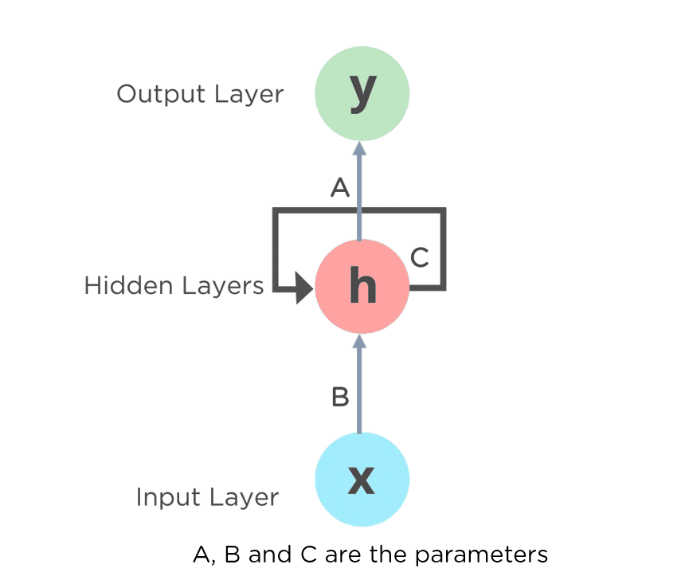
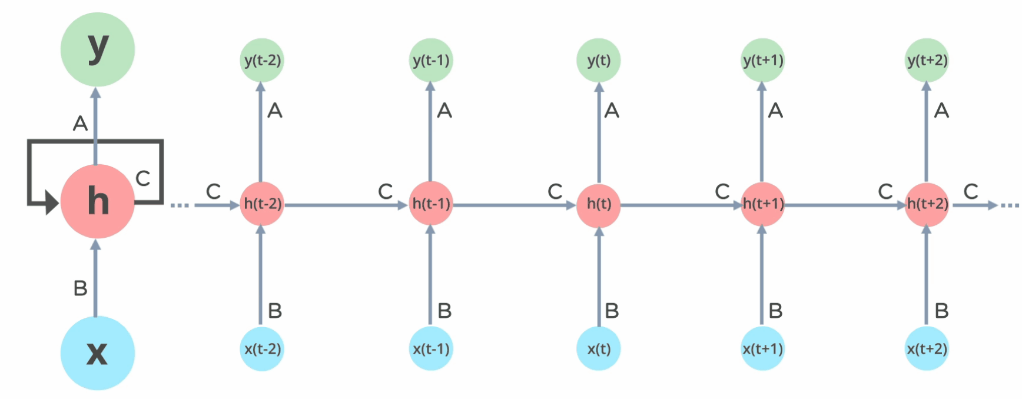
Recurrent Neural Networks
Temporal problems
Recurrent connections
Directed graph along a temporal sequence
Exhibits temporal dynamic behavior
Internal state (memory)
https://machinelearningknowledge.ai/

Slide 7
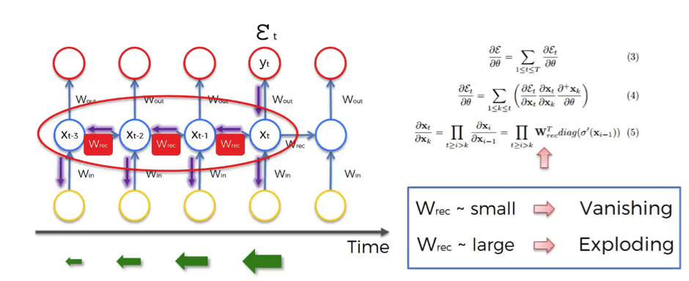
Recurrent Neural Networks
Limitations and problems
  Notoriously difficult to train
  Back-propagation through time
  Unfolding network in time
  Computationally inefficient
  Vanishing gradient issue
Solutions
  Gated RNNs: LSTM, GRUs
  New learning paradigm: reservoir computing (RC)

Slide 8
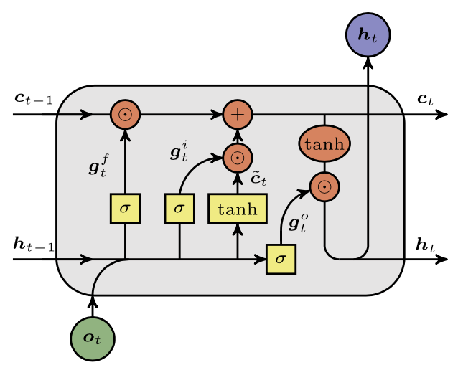
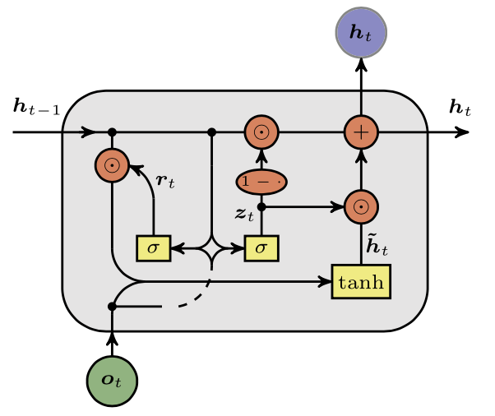
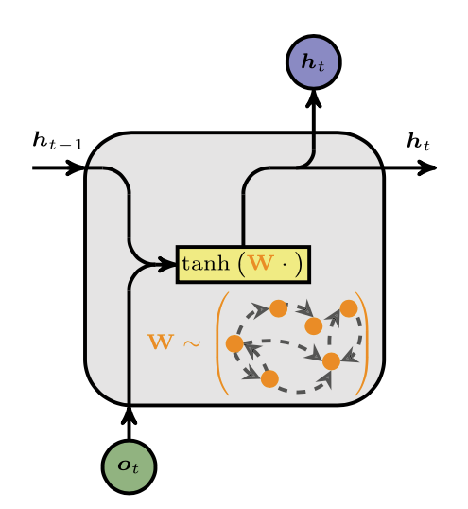
Recurrent Neural Networks
LSTM GRU
RC
Possessing an internal high-dimensional hidden state
  Enabling the encoding of temporal dependencies on past state history
  General form of the models
  The difference is in the realization of mapping functions
hidden-to-hidden mapping
hidden-to-output
mapping
Vlachas, Pantelis R., et al. "Backpropagation algorithms and reservoir computing in recurrent neural networks for the forecasting of complex spatiotemporal dynamics." Neural Networks 126 (2020): 191-217.

Slide 9
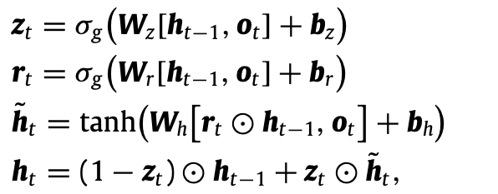
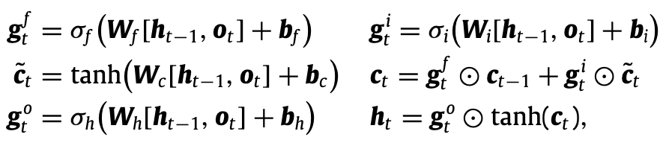

Gated RNNs
Long short-term memory
  Gating mechanism
  Allows information forgetting
Gated recurrent units (GRU)
  Simplified version of LSTM
  Combining forget and input gates
g: gate vector signals
c: cell state
W, b: wights and biases
superscripts:
f: forget
i: input
o: output
z: update gate
r: reset gate

Slide 10


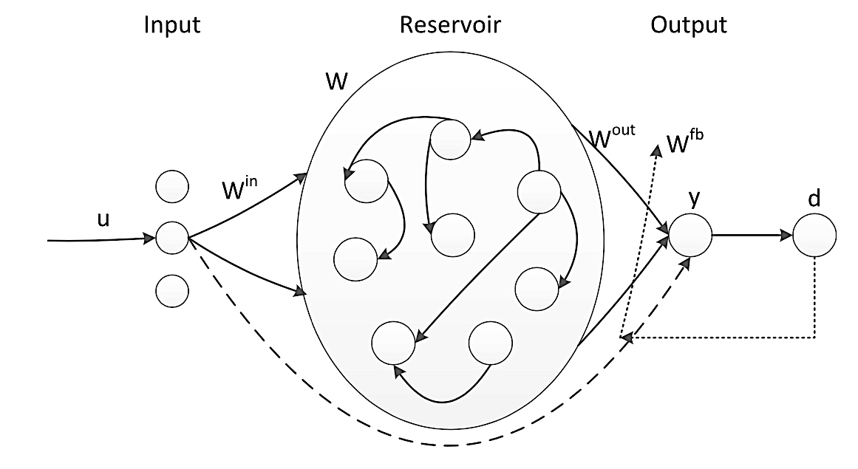
Reservoir Computing
Learning paradigm derived from recurrent neural networks (RNNs)
  Echo state network (ESN)
Simple structure containing a reservoir of randomly connected neurons with immutable weights
  Input layer: Immutable random weights
  Output layer (“readout”): Trainable weights
Low computational costs
Promising results in processing high-dimensional temporal data, modeling nonlinear dynamical systems
Reservoir Weights
Output Weights
Input Weights
Feedback Weights
Input Signal
Reservoir State
Output Signal

Slide 11
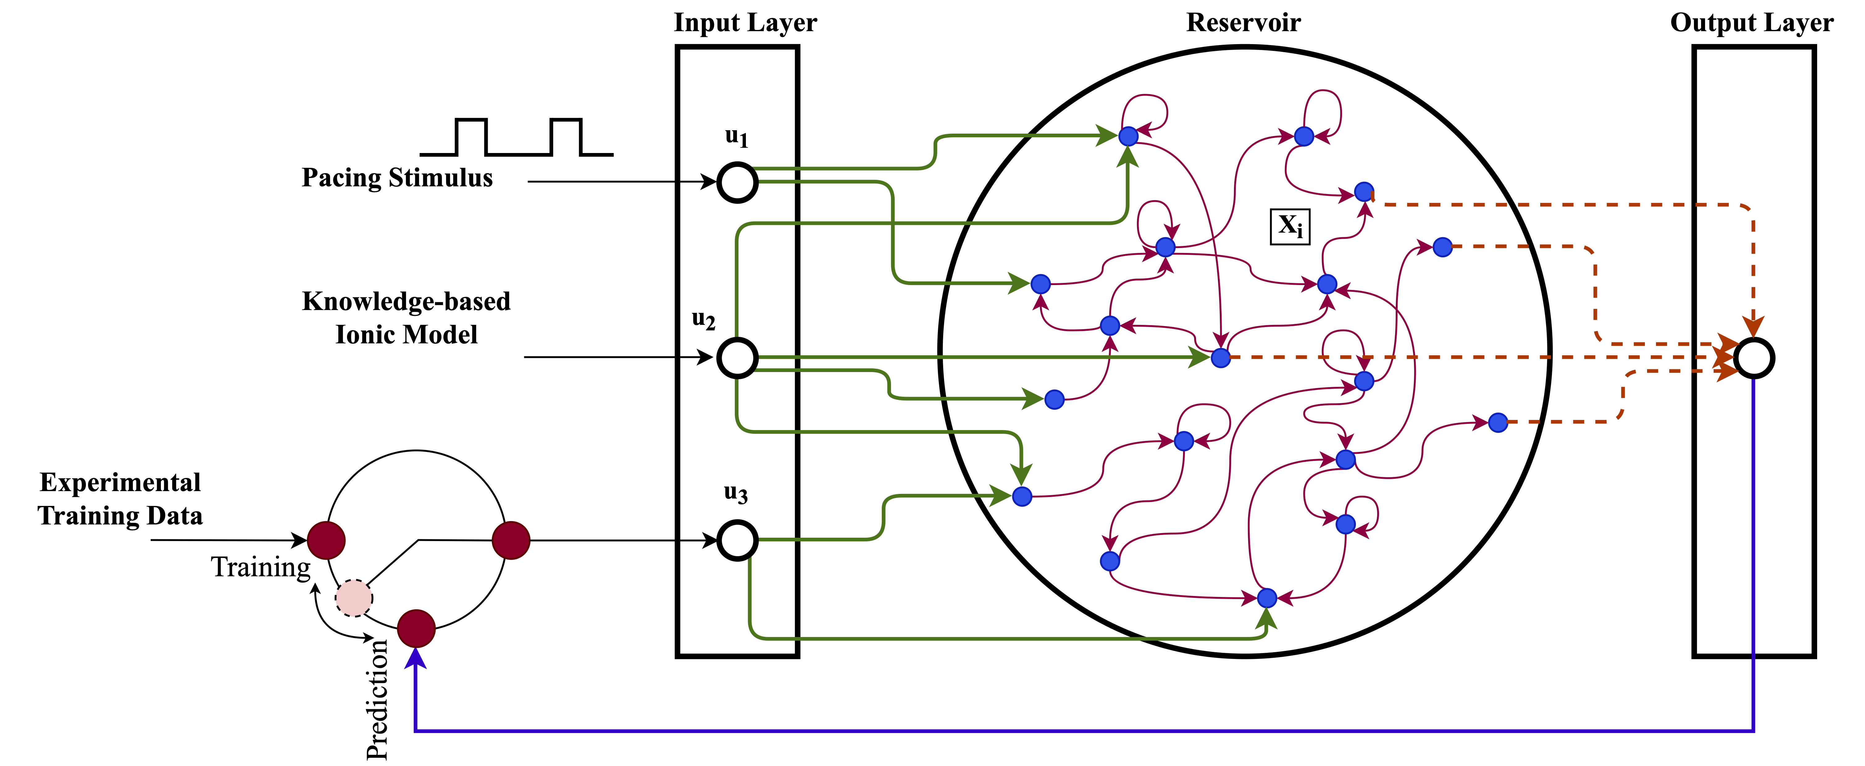
Hybrid ESN
Physics-informed approach
  Integrating a knowledge-based model into ESN
  Input signals:
    Pacing stimulus
    Knowledge-based model
    Measurements
Synchronizing the model components
Pacing the knowledge-based model, the detailed model, and the reservoir at the same PCL
A [usually] simple mathematical model, e.g., Fenton-Karma, Corrado-Niederer
Approximation of the dynamical behavior
Increasing the predictive ability of the hybrid model
Experimental data
Synthetic data generated by detailed electrophysiological ionic models

Slide 12
Hybrid ESN
Components:
  Reservoir:
    Randomly connected
    Immutable weights
    Leaky integrator neurons
    Time evolution
  Readout layer:
    Outputs are computed by a linear combination of functions of the internal state variables
    Ridge Regression
Reservoir weights
Input weights
: Leaky integrator parameters
Reservoir state
Input signal

Slide 13
Experiments
Benchmarks
  Mackey-Glass
  Lorenz
  Cardiac action potential
    Models of cardiac electrical dynamics
      Fenton-Karma (random stimulus)
      Beeler-Reuter (random stimulus)
      Noble (chaotic)
    Experimental data
Evaluation metrics
  Prediction accuracy
    MSE, RMSE
    APD
  Computation time
  (computational efficiency)
Testing protocol
  Fixed number of neurons
  Tuned hyperparameters
    Grid search, particle swarm, and SQP
  Averaging over multiple runs

Slide 14
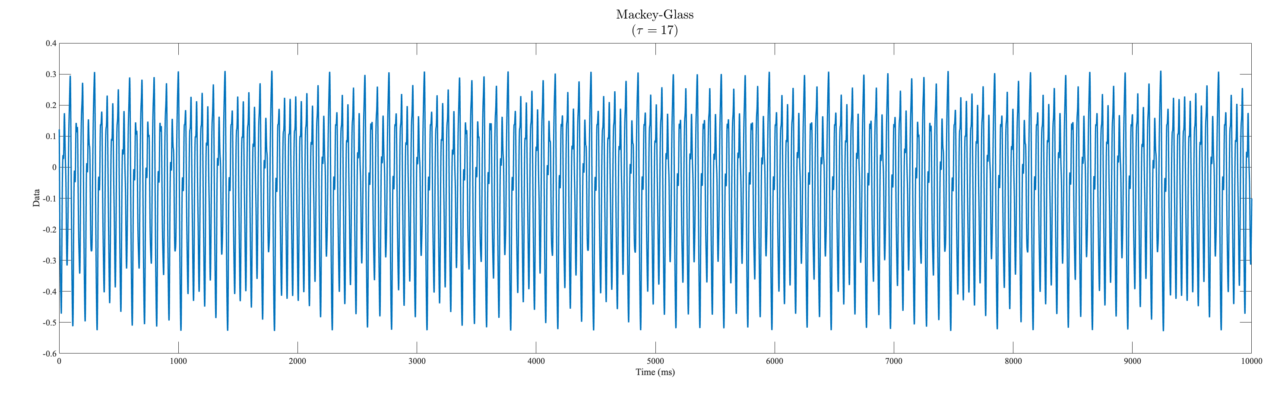

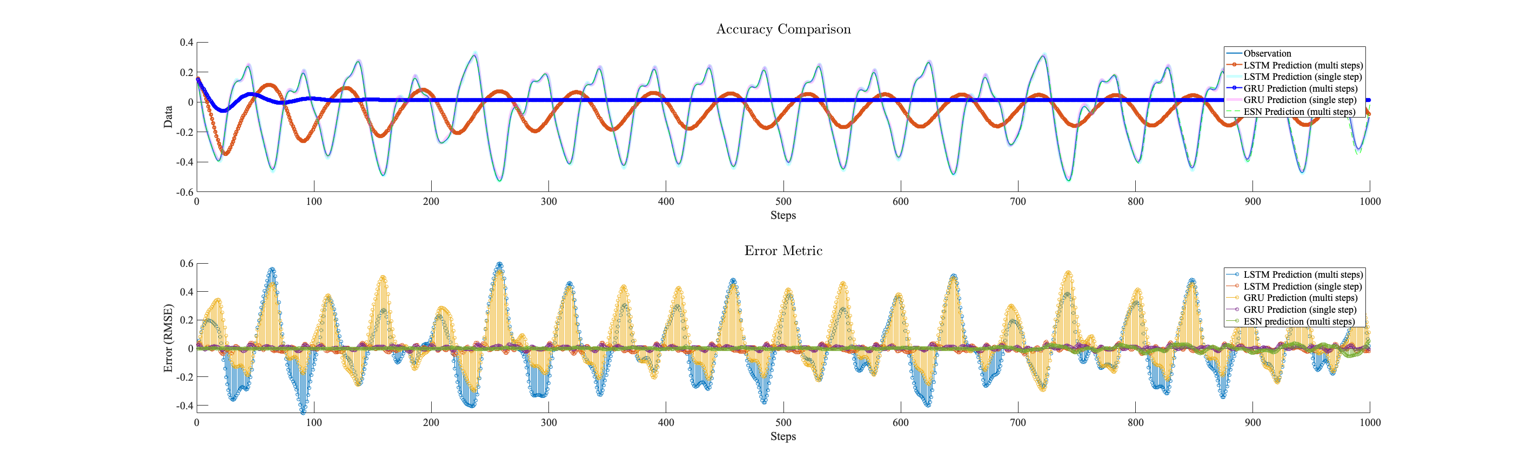
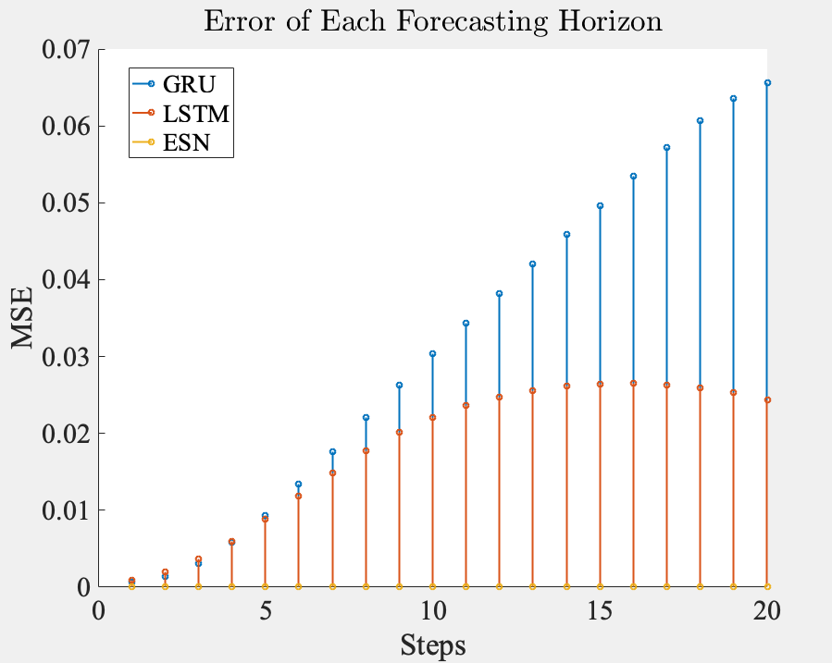

Benchmark: Mackey-Glass
Mackey-Glass delay differential equation
  Chaotic behavior $τ=17, β=0.2, γ=0.1, n=10$
ESN
LSTM (one-step)
GRU (one-step)

Slide 15
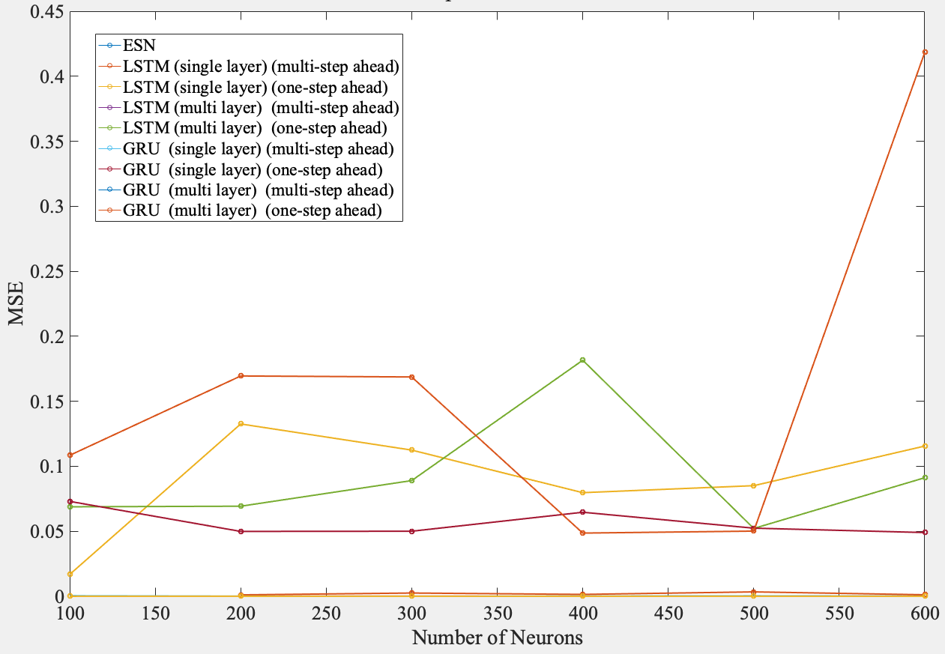
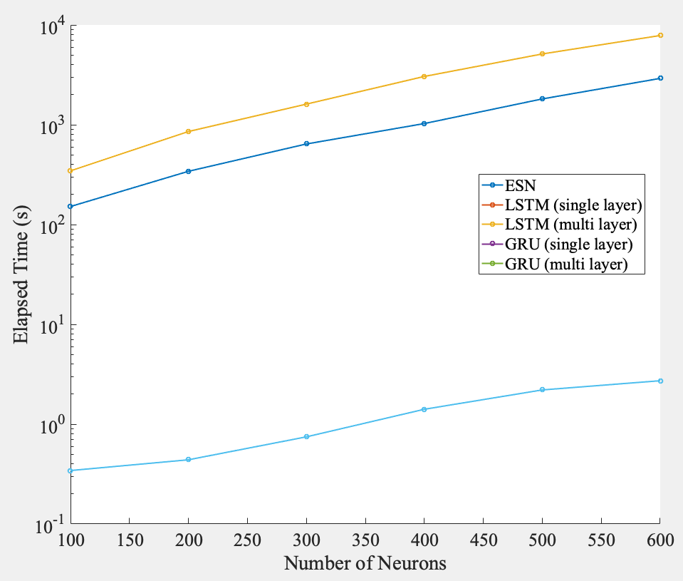
Benchmark: Mackey-Glass
Mackey-Glass delay differential equation
  Poor results of gated RNNs are not a result of bias in the model
  Increasing network complexity

Slide 16
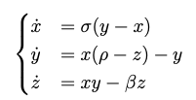
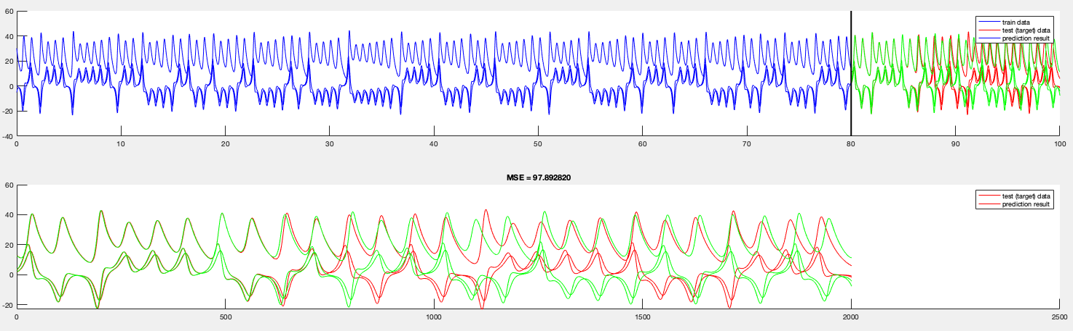

Benchmark: Lorenz System
Lorenz system
  Simplified model for atmospheric convection
  Chaotic dynamical system; close initial conditions lead to very different trajectories
    $σ=10, ρ=28, β=8/3$
  Gated RNNs are unsuccessful.
  Successful prediction using ESN (Forecasting horizon = 500 steps)

Slide 17
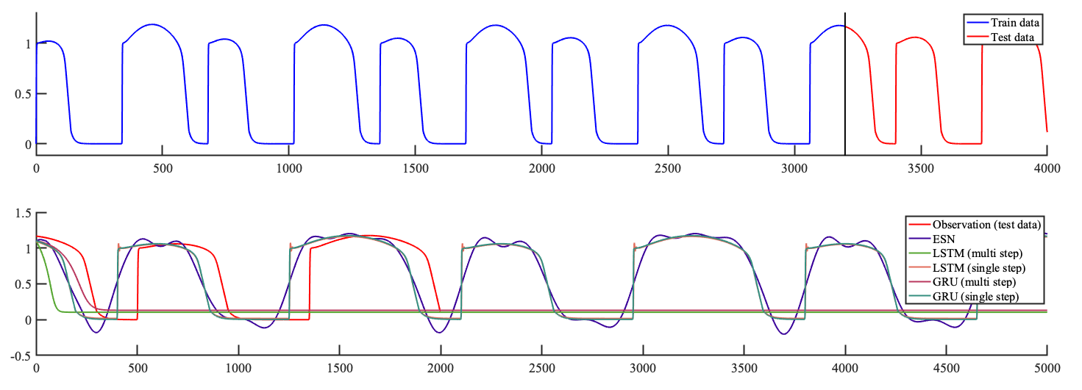
Cardiac Action Potential
Fenton-Karma
  3 variable model
  Gated RNNs and ESN are not successful
  Physics-informed approach; hybrid ESN

Slide 18
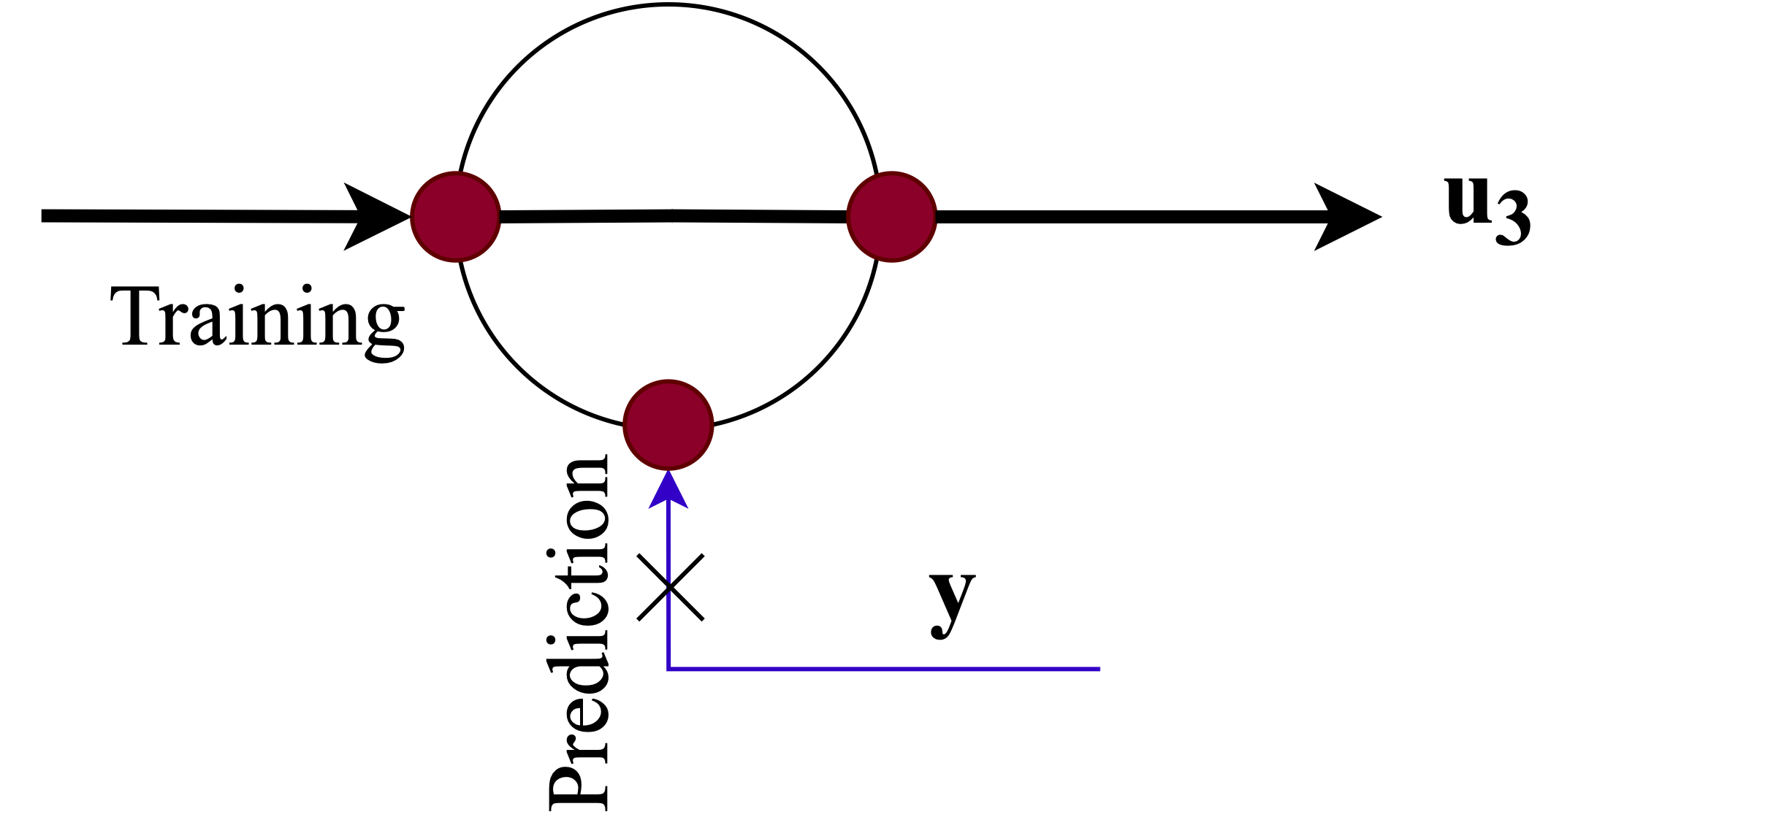
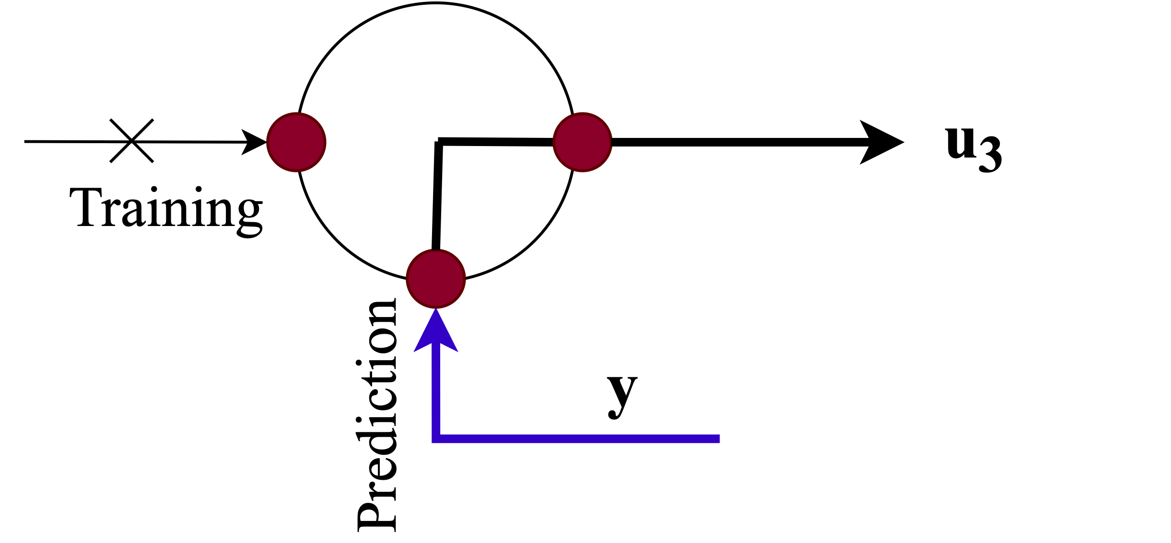
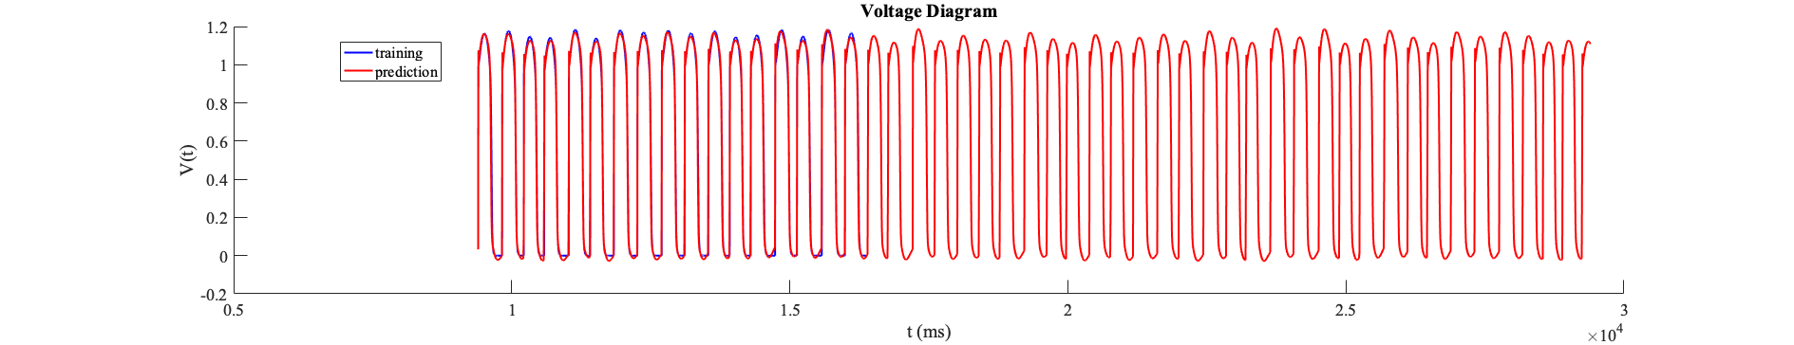
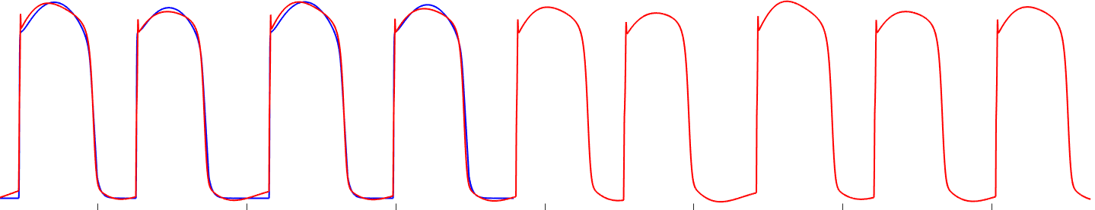
Cardiac Action Potential
Hybrid ESN
Modeling the cardiac cell membrane voltage
Pacing protocol
  PCL=380 ms
  Perturbation std = 20 ms

Slide 19
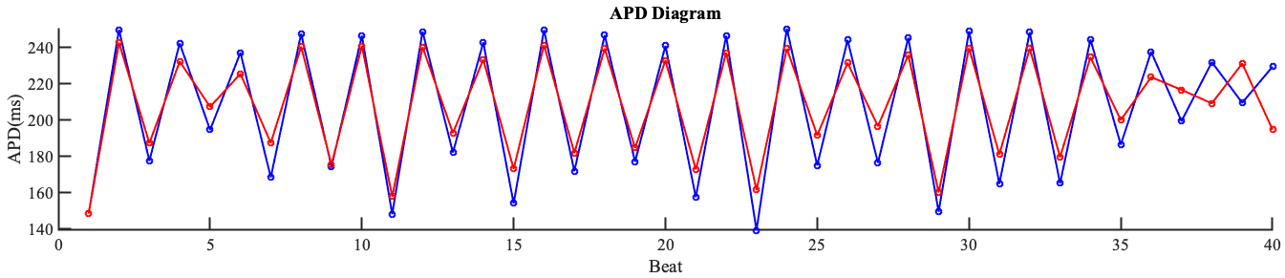
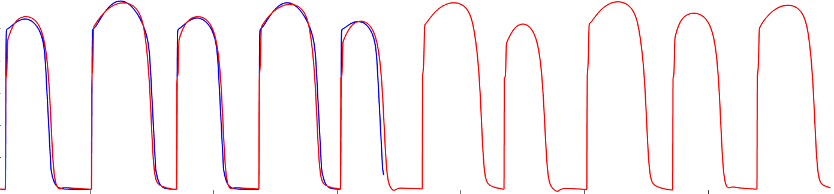
Cardiac Action Potential
Hybrid ESN
Prediction of action potentials in the presence of alternans
Pacing protocol
  PCL=320 ms
  Perturbation std = 10 ms

Slide 20
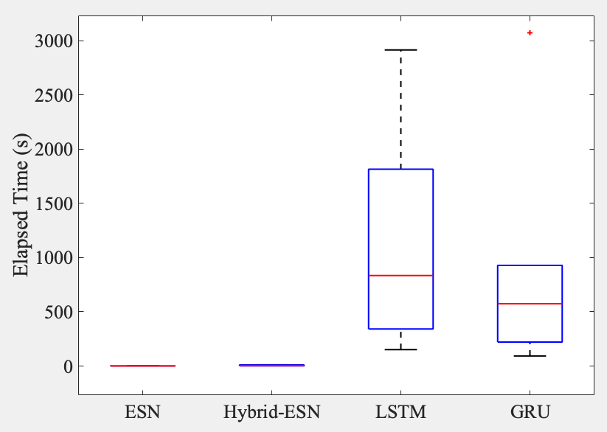
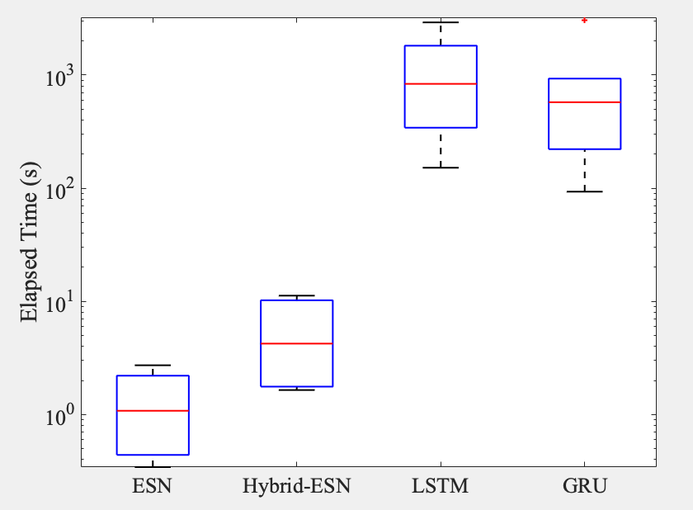
Computational Efficiency
Computation time
  ESN < Hybrid-ESN << GRU < LSTM

Slide 21
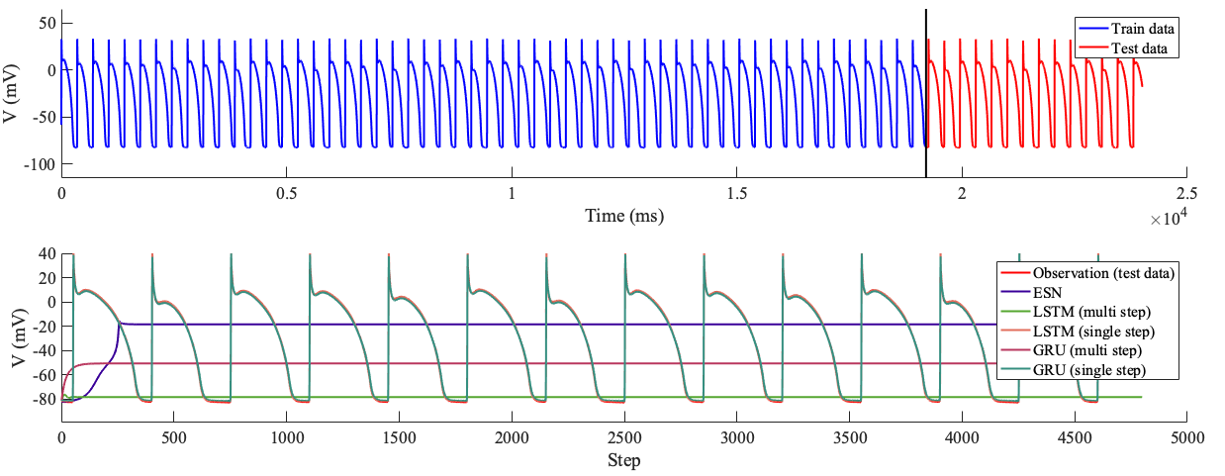
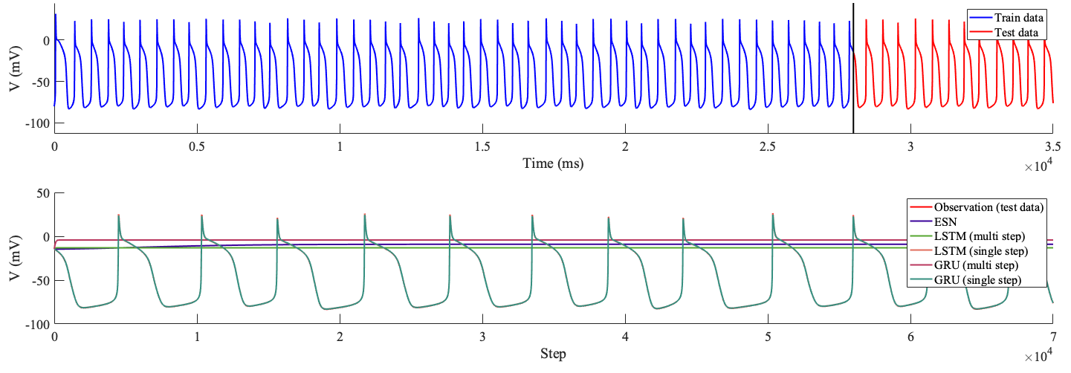
Cardiac Action Potential
Beeler-Reuter
  Gated RNNs ✕
  Regular ESN ✕
Noble
  Chaotic behavior
  Driven by Lorenz
  Gated RNNs ✕
  Regular ESN ✕

Slide 22
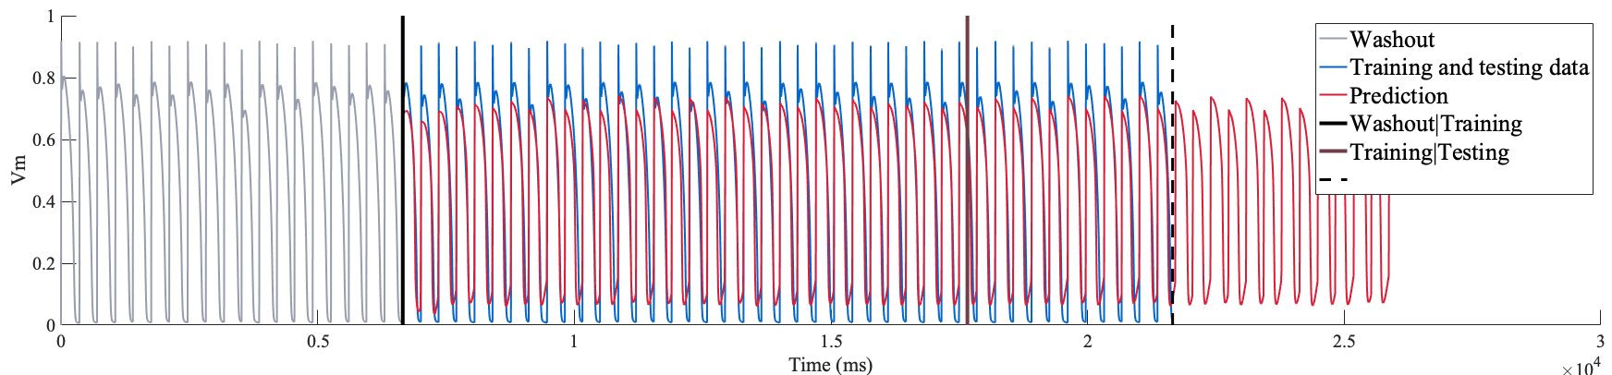
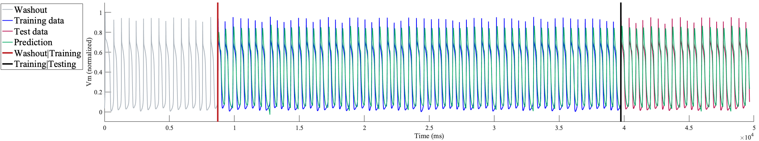
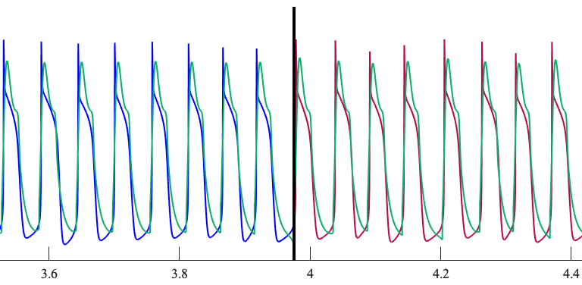
Cardiac Action Potential
Beeler-Reuter
  Gated RNNs ✕
  Regular ESN ✕
  Hybrid ESN ✓
Noble
  Gated RNNs ✕
  Regular ESN ✕
  Hybrid ESN ✓

Slide 23
Summary and Conclusion
Comparative study of deep learning techniques for modeling nonlinear time series; particularly, cardiac action potentials
Conventional RNNs and the gated versions, such as LSTM and GRUs, can be used for regular time-series forecasting tasks, but they are not successful for chaotic time series prediction.
Can still be used in single-step forecasting and multi-step forecasting with a few steps ahead (usually less than 50), but not a good choice for long forecasting horizons.
For long forecasting horizons, reservoir computing approaches will be a better choice.
In terms of computational effort, reservoir computing approaches are comparably less expensive.
RNNs are compute-intensive.
In terms of robustness, reservoir computing techniques are more sensitive to hyperparameters and initial parameter values.
For modeling cardiac action potentials, the physics-informed framework provided by the hybrid ESN is the most successful approach, but it still needs more improvements to increase robustness.

Slide 24
Acknowledgements
Supported by the National Science Foundation grant CMMI-2011280
SIAM travel award supported by the National Science Foundation

Slide 25
Thank you!
Q/A

Slide 26
Additional Slides

Slide 27
Reservoir Computing
Echo State Networks
Reservoir Weights
Construction
  Input layer
    Immutable random
    weights
  Reservoir
    Recurrent network
    of neurons
    Randomly connected neurons
    Immutable weights
  Output layer
    Called “readout”
    Trainable weights
    Linear regression
Output Weights
Input Weights
Feedback Weights
Output Signal
Input Signal
Reservoir State

Slide 28
Computational Framework
Components:
  Reservoir:
    Randomly connected
    Immutable weights
    Leaky integrator neurons
    Time evolution
Reservoir weights
Input weights
: Leaky integrator parameters
Reservoir state
Input signal
Global time constant
Leaking rate

Slide 29
Computational Framework
Components:
  Readout layer:
    Outputs are computed by a linear combination of functions of the internal state variables
    Readout weights

Slide 30
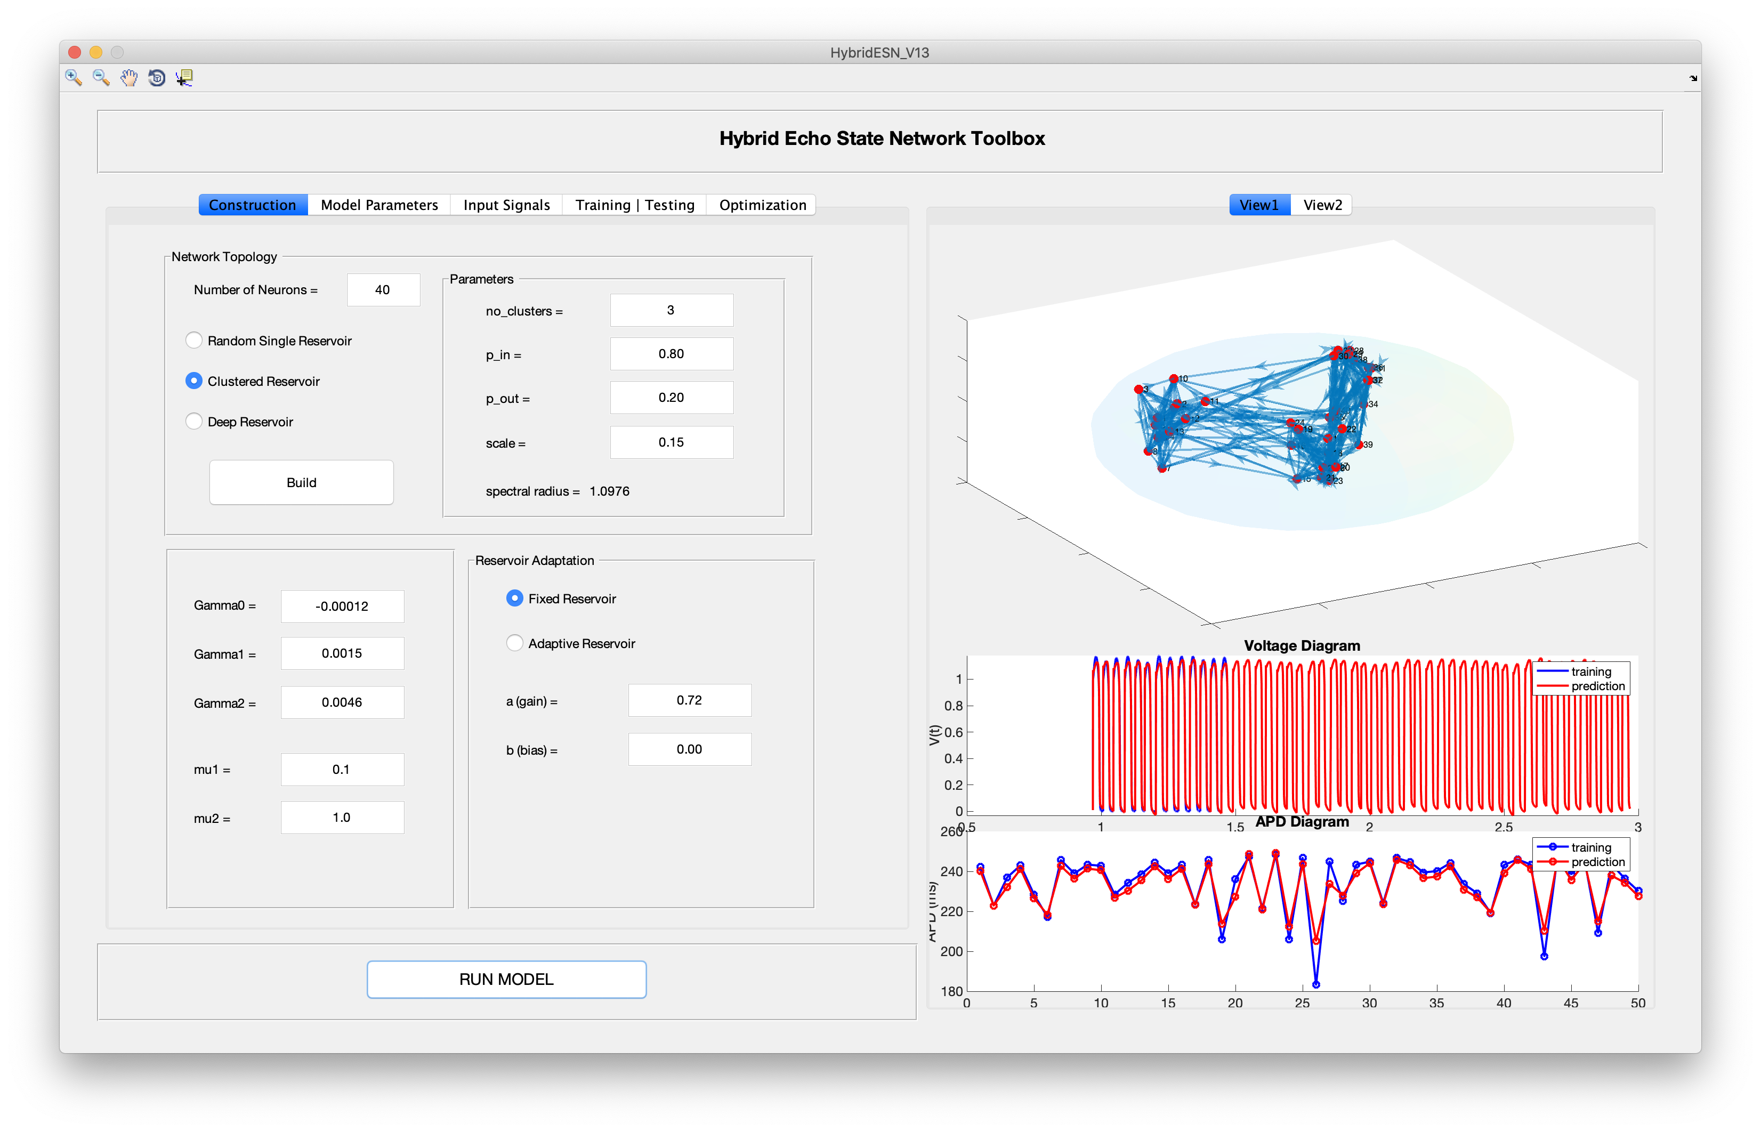
Computational Framework
Implementation
  Developing a general-purpose reservoir computing computational package
    Extendable
    Hybrid approach
    Graphical user interface
    Visualization tools
    MATLAB, Java
    Supporting Python, Fortran

Slide 31
Improvements
Reservoir Architecture Enhancement
  Various reservoir topologies
    Clustered hybrid ESN

Slide 32
Improvements
Reservoir Architecture Enhancement
  Various reservoir topologies
    Clustered hybrid ESN
      Reservoir dynamical behavior
      Readout connections

Slide 33
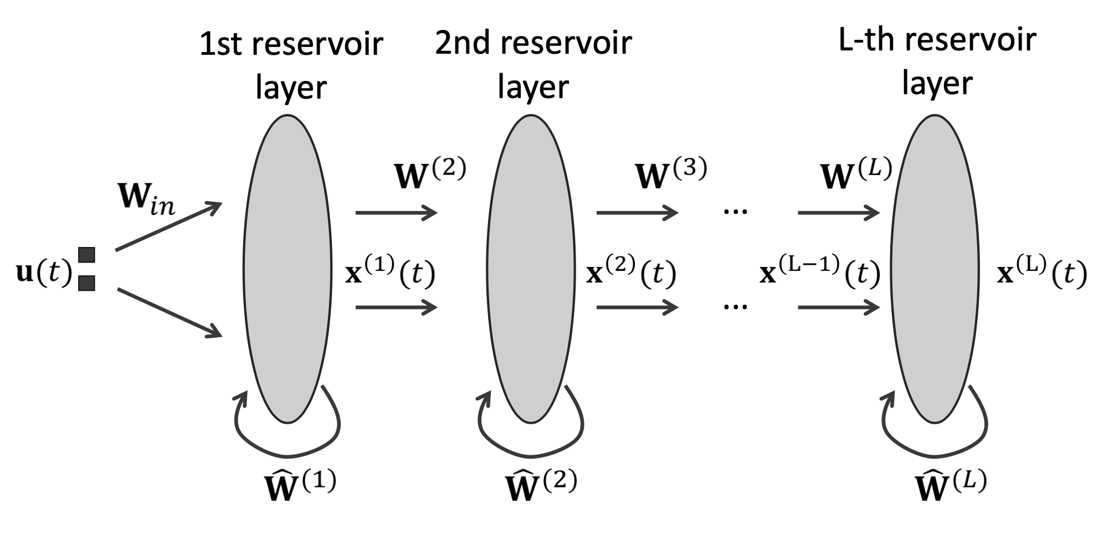
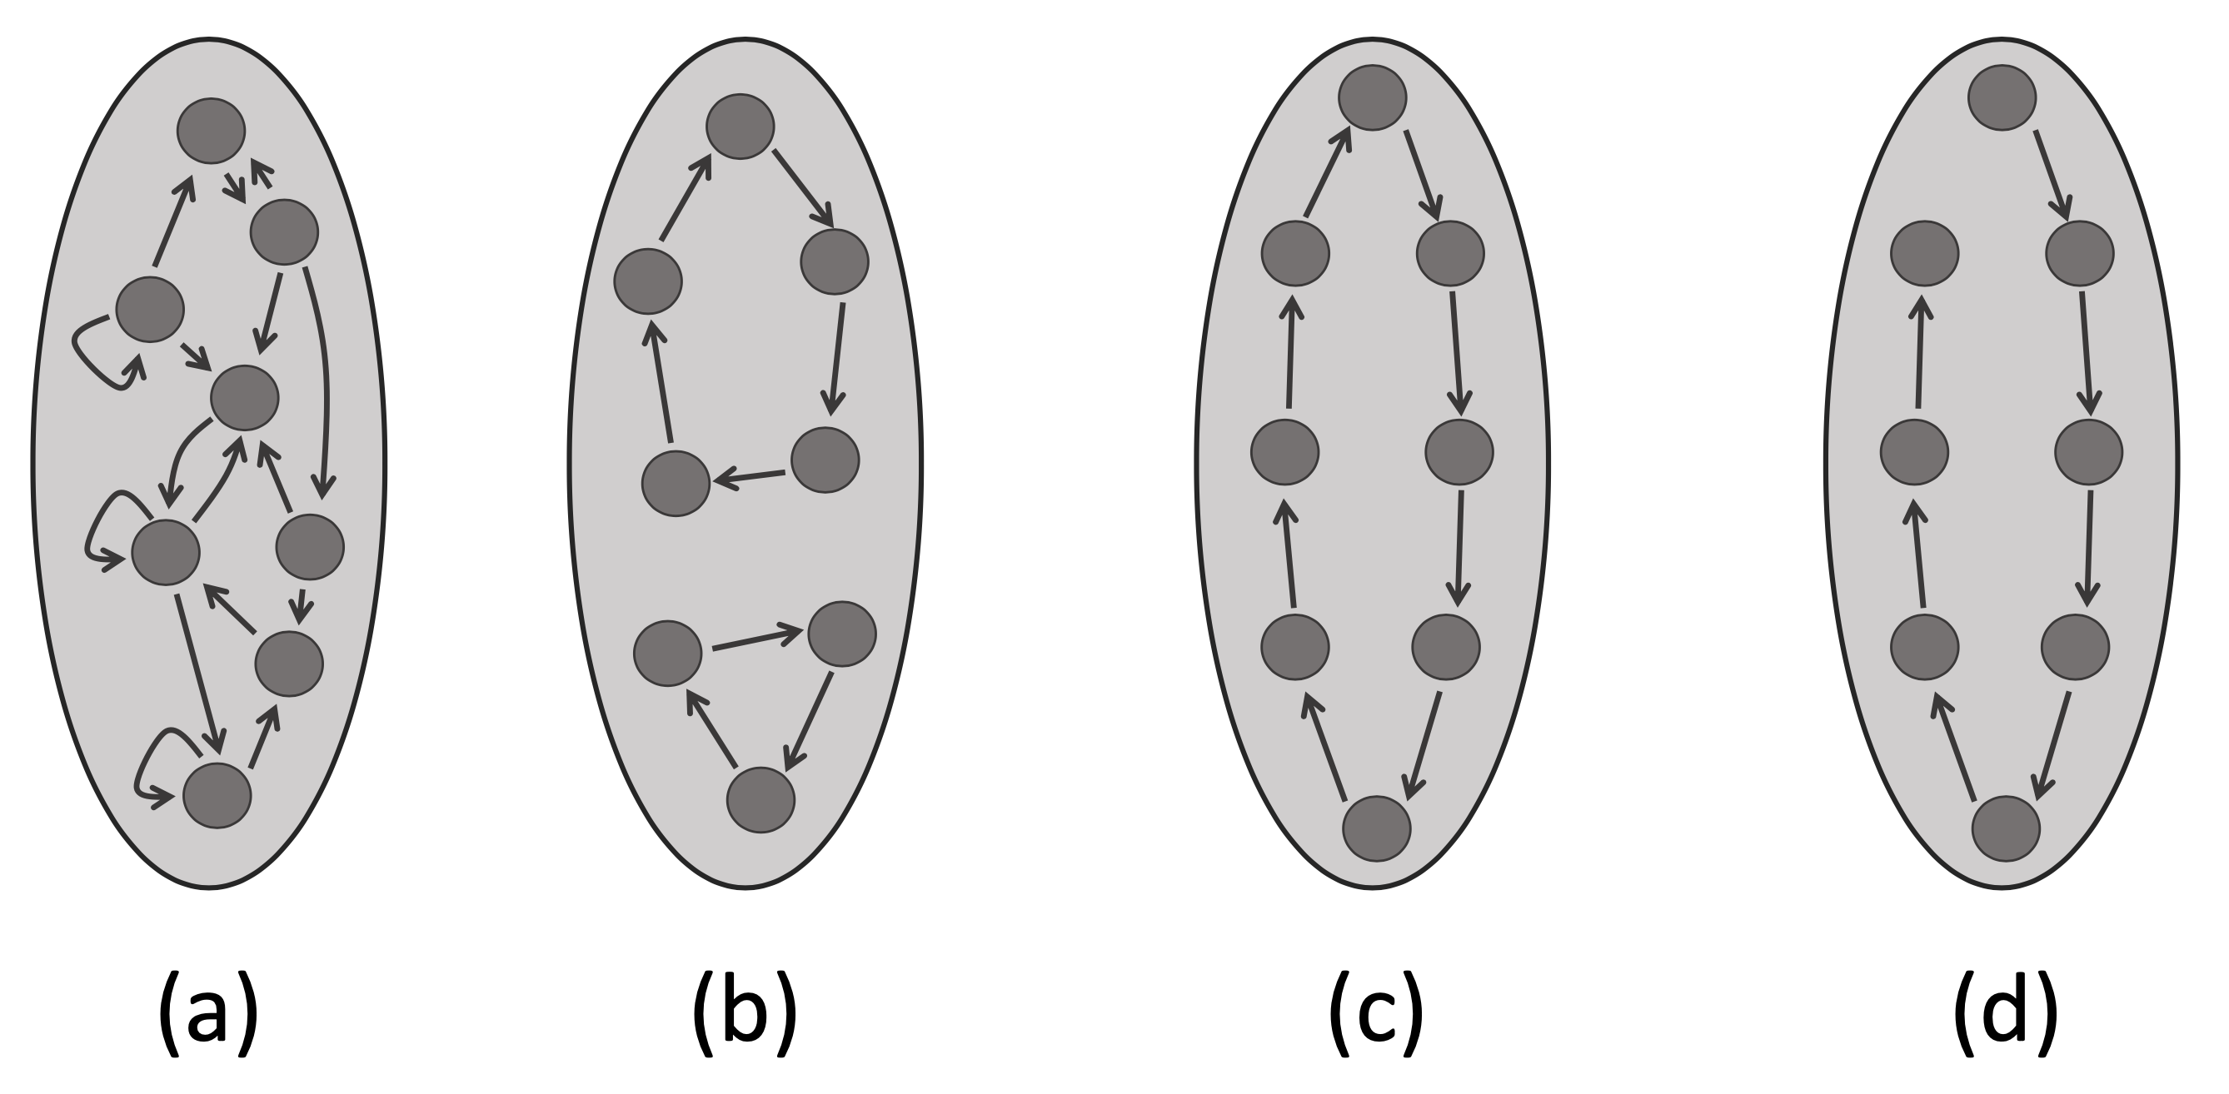
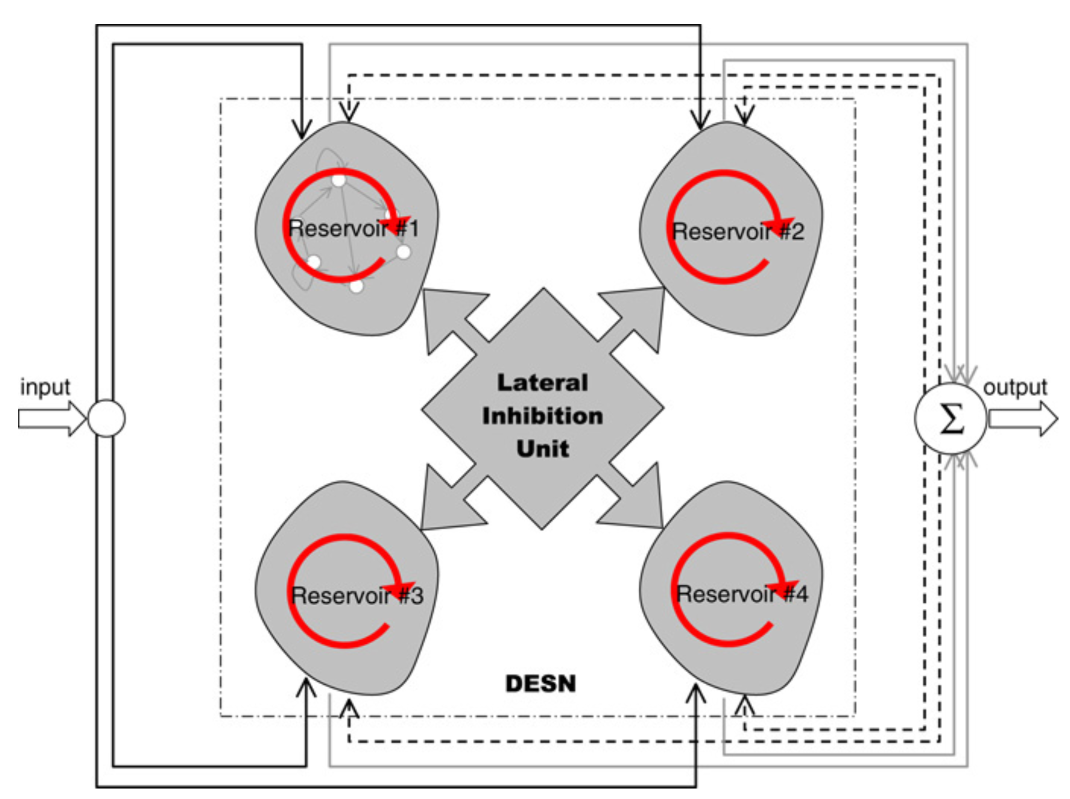
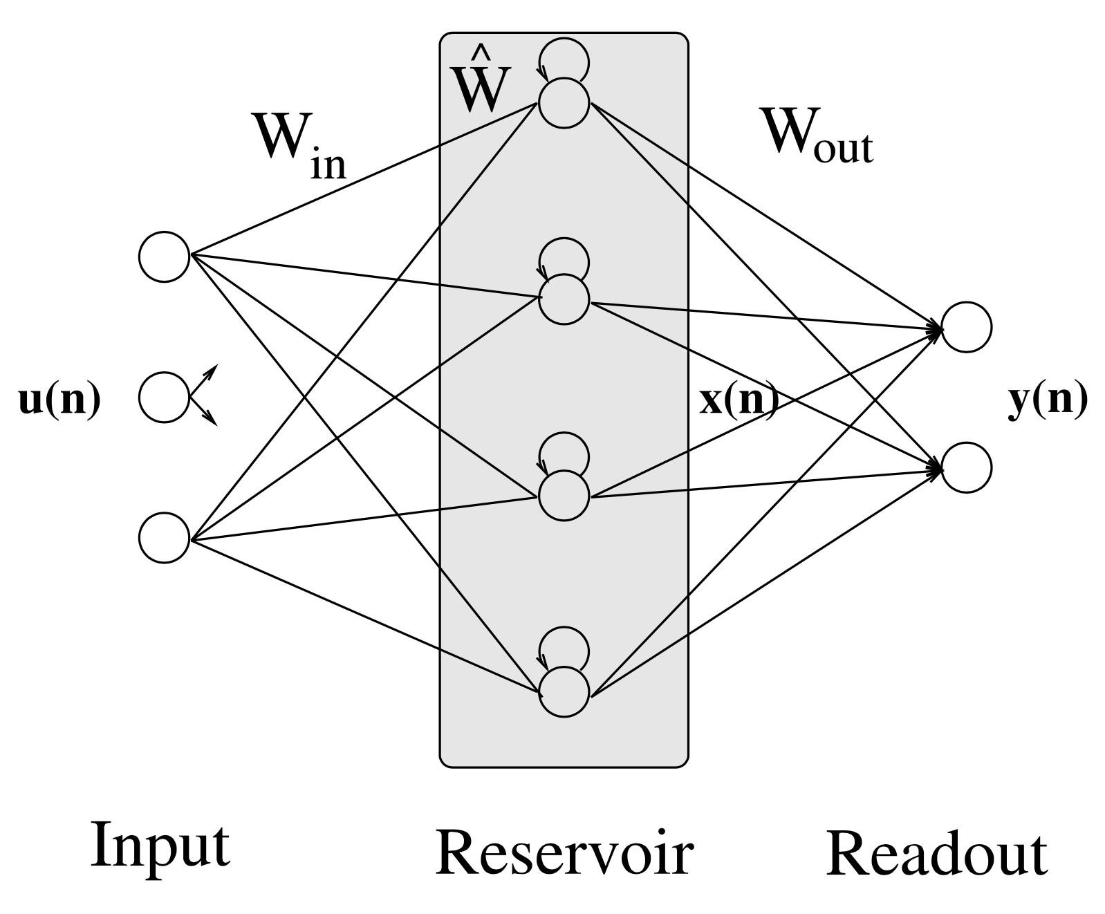
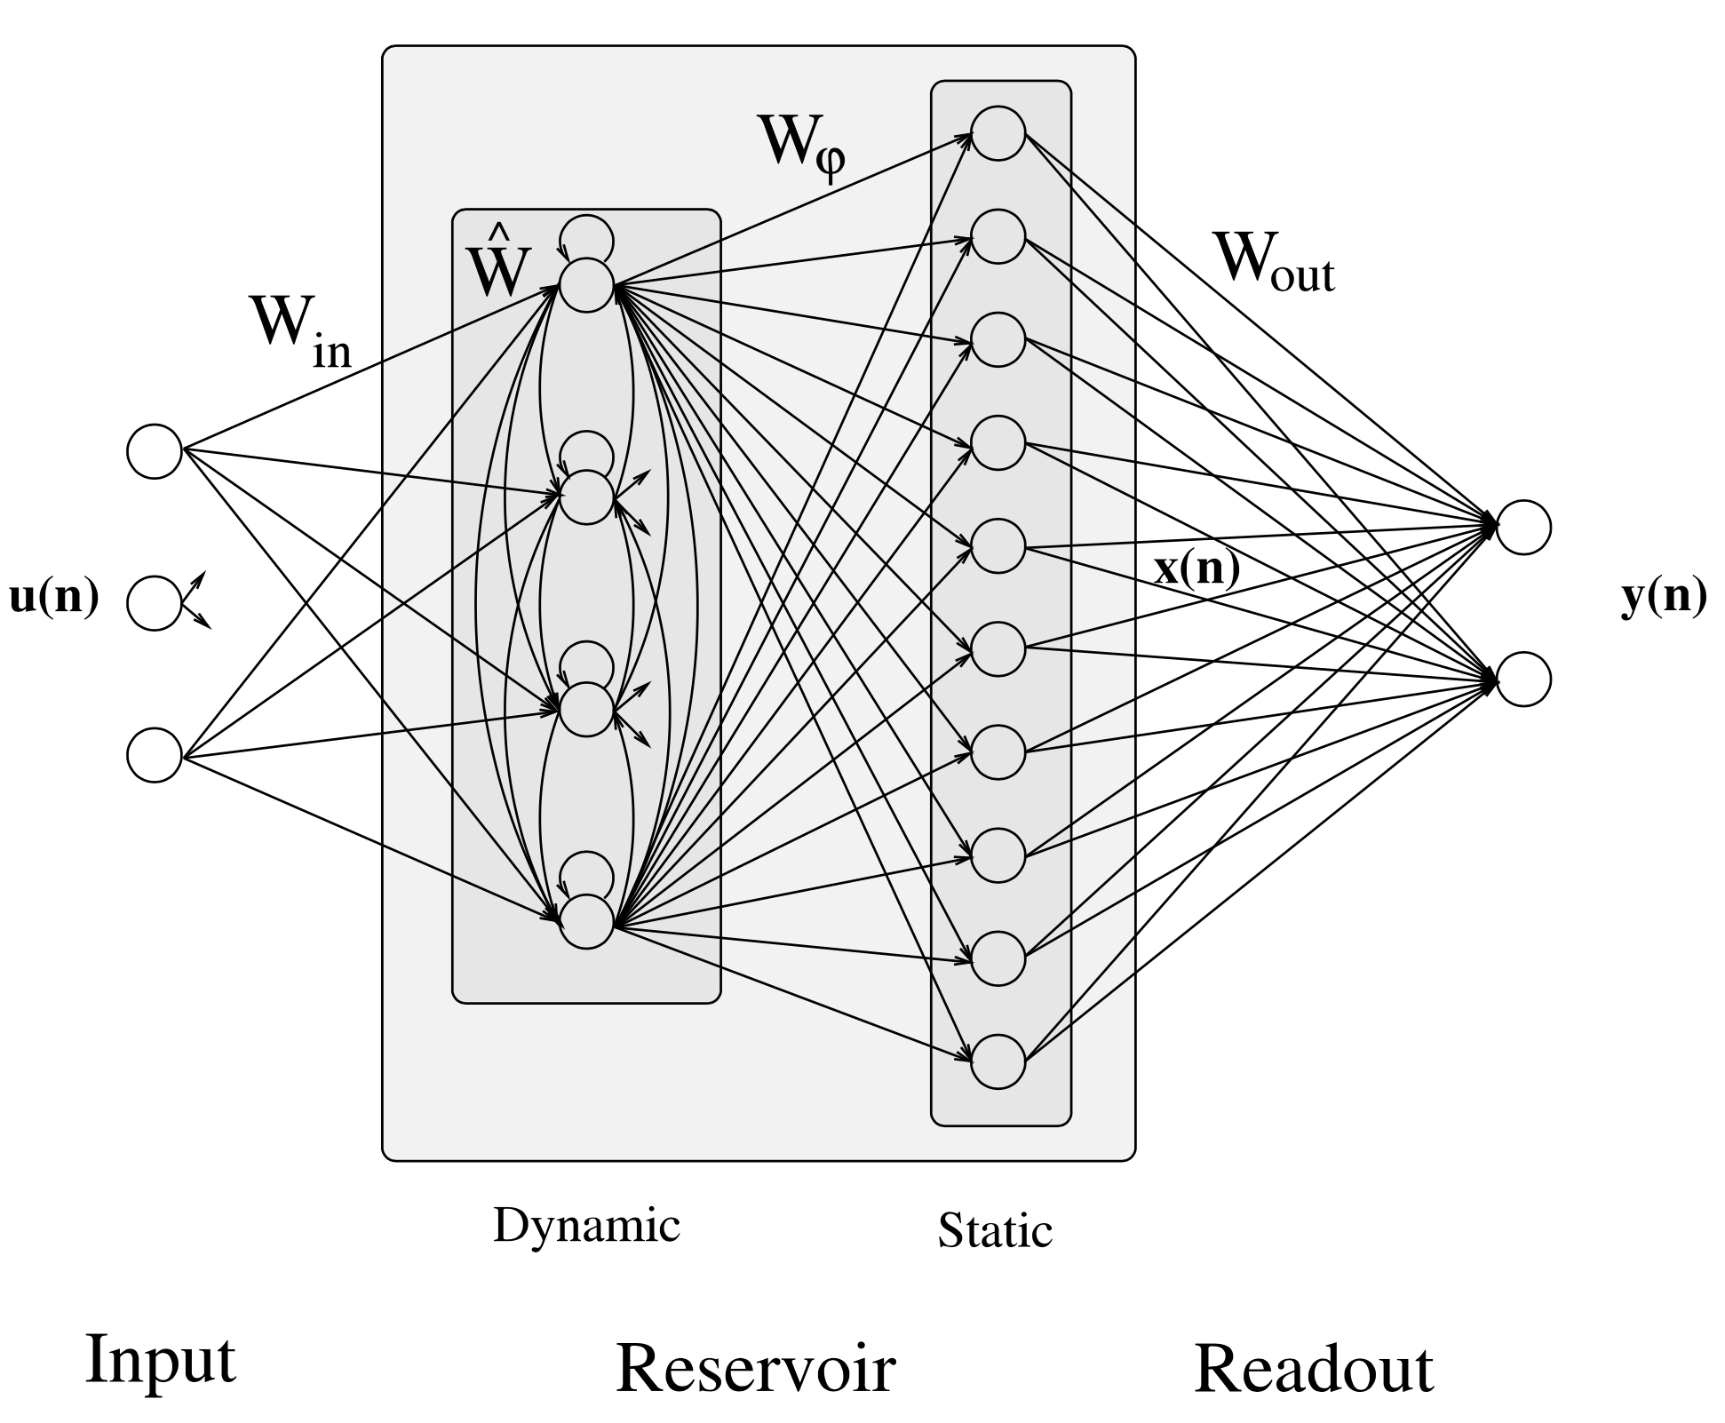
Improvements
Reservoir Architecture Enhancement
  Various reservoir topologies
    Clustered hybrid ESN
    Other topologies
      Multi-layered and Deep ESNs
      Decoupled ESN
      Diagonal ESNs
[1] Xue, Y., Yang, L., & Haykin, S. (2007). Decoupled echo state networks with lateral inhibition. Neural Networks, 20(3), 365-376.
[2] Gallicchio, C., & Micheli, A. (2019, September). Reservoir Topology in Deep Echo State Networks. In International Conference on Artificial Neural Networks (pp. 62-75). Springer, Cham.
[3] Gallicchio, C., & Micheli, A. (2011). Architectural and markovian factors of echo state networks. Neural Networks, 24(5), 440-456.

Slide 34
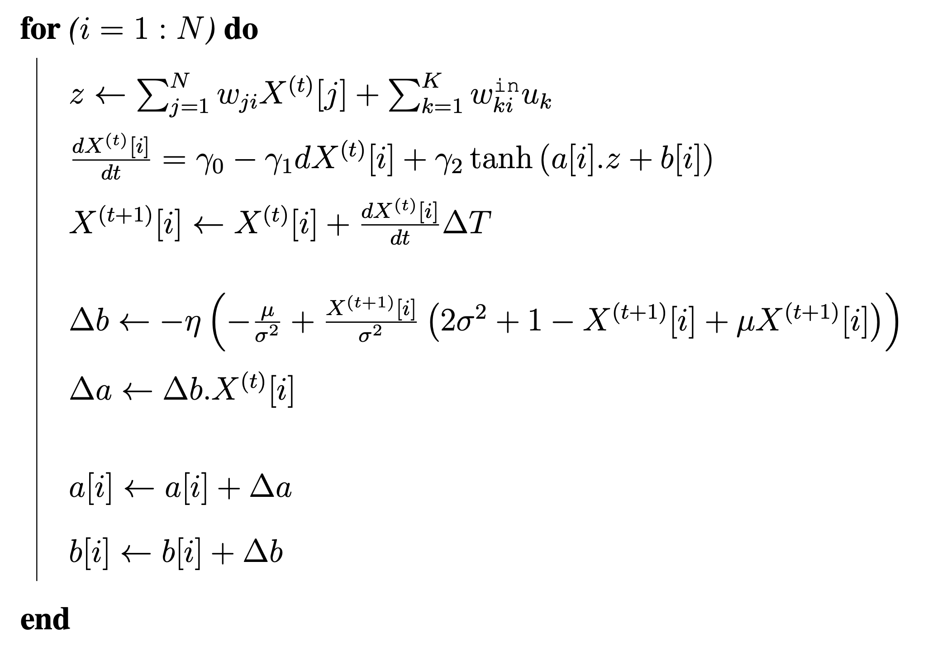
Improvements
Reservoir Adaptation Approaches
  Intrinsic plasticity
    Biological Neurons
      Adjusting the level excitability
      Fixed average firing rate
    Learning rules:
      Information maximization
      Constraints on the output distribution
      Adapting the neurons’ intrinsic parameters
    Gradient descent update rules:
gain
bias

Slide 35
Improvements
Evolutionary Optimization Approaches
  Particle swarm optimization (PSO)
  Generic algorithm (GA)
ESN Internal Properties
  Echo state property
  Memory capacity
Knowledge-based Model
  Promoting prediction ability
  Contribution
    Various level of complexity
    Computational overhead
  Connection to the reservoir
    One or several node(s)
    One or multiple cluster(s)
    One or multiple layer(s)
    Direct link to readout layer

